Slide 1
7:- Dataset iris contains 50 samples from each of 3 species of Iris (Iris setosa, Iris virginica and Iris versicolor). Split the data into training and test data. Build naive bytes for this data.

Slide 2
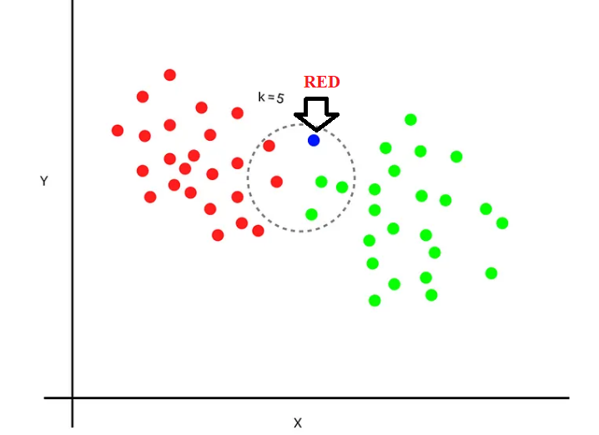
K-Nearest Neighbors

Slide 3

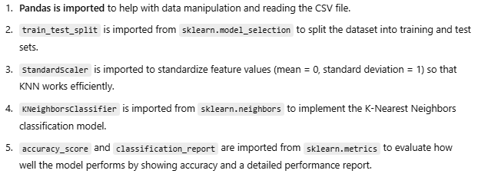

Slide 4
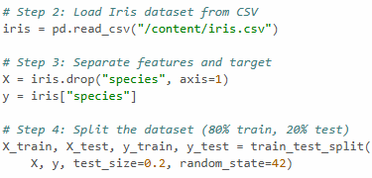


Slide 5
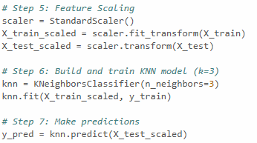


Slide 6
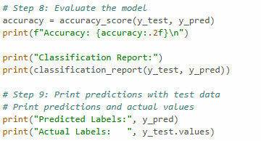


Slide 7
